Slide 1
East Hills Wood
From brambles back to bluebells

Slide 2
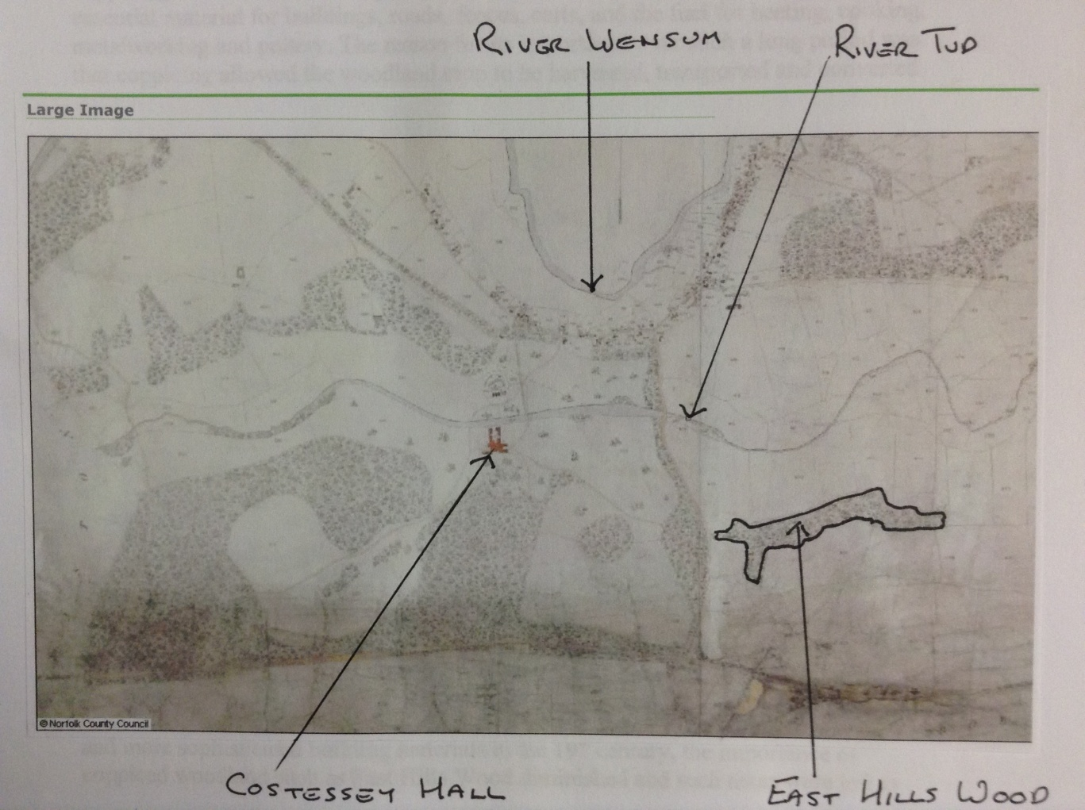
The Venue – East Hills Wood
(from 1839 Ordnance Survey map)

Slide 3
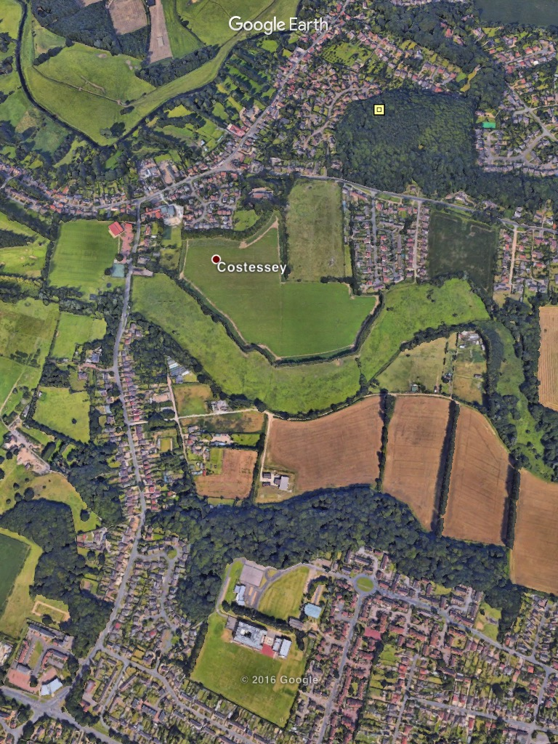
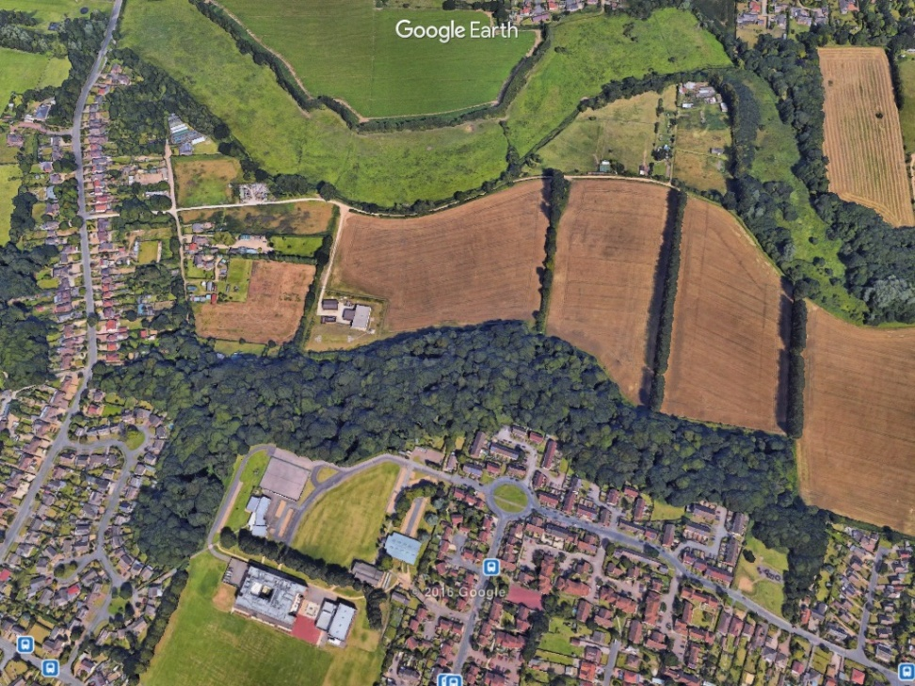
East Hills Wood (from GoogleMap)

Slide 4
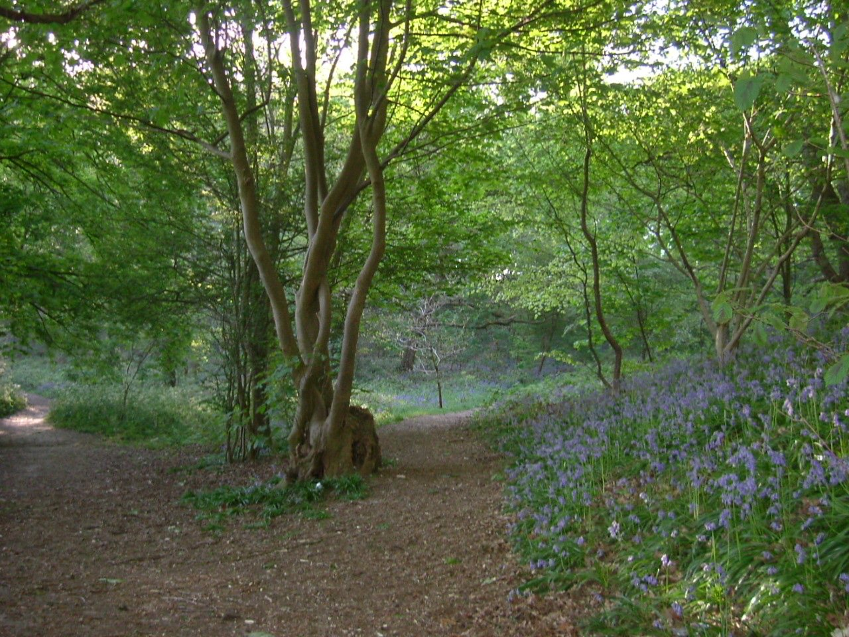
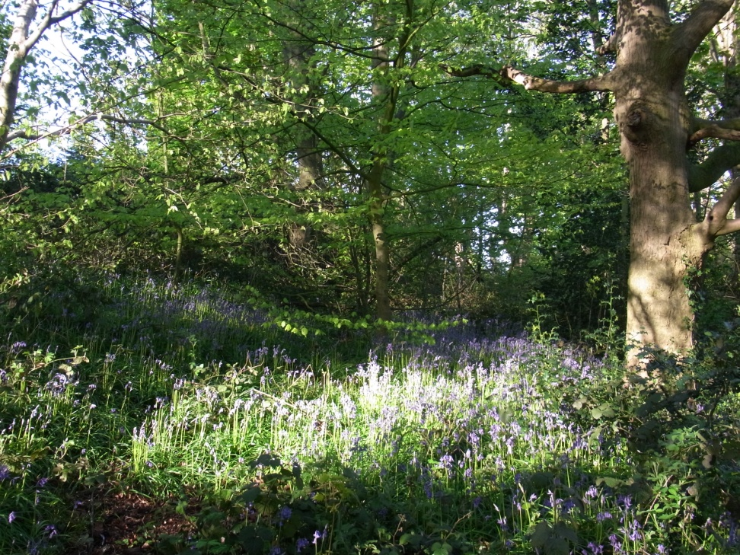
Views of bluebell glades, 10 years ago

Slide 5
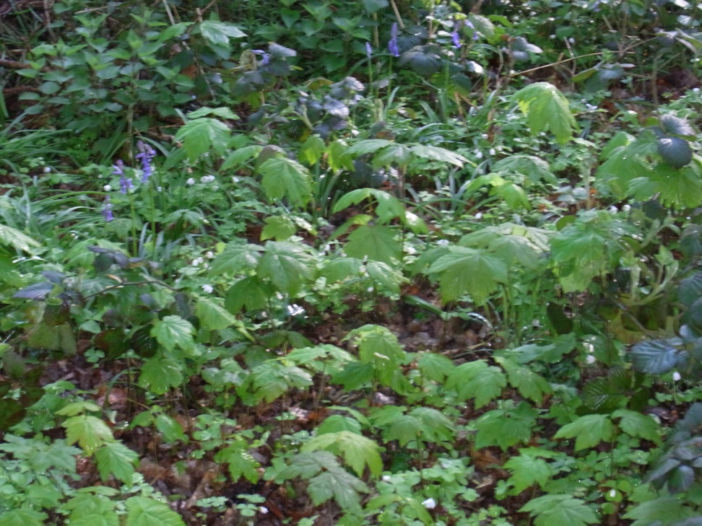
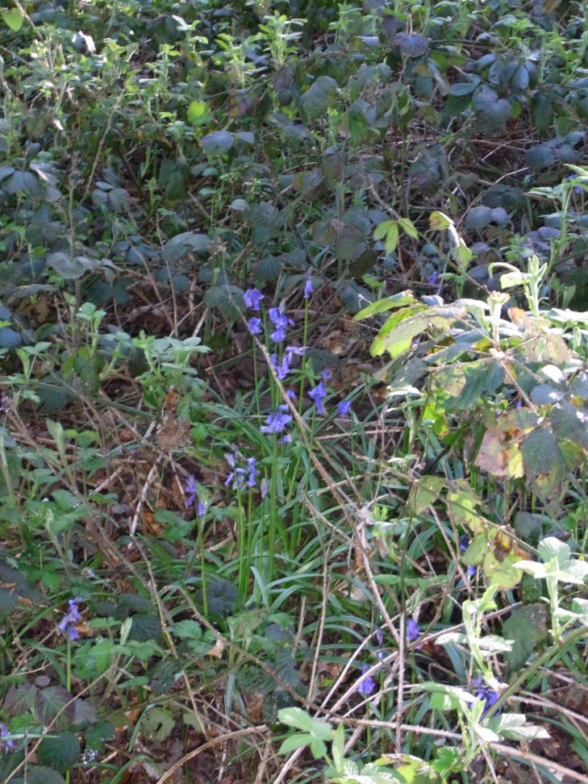
And now, bluebells struggle through the brambles and sycamore seedlings:

Slide 6
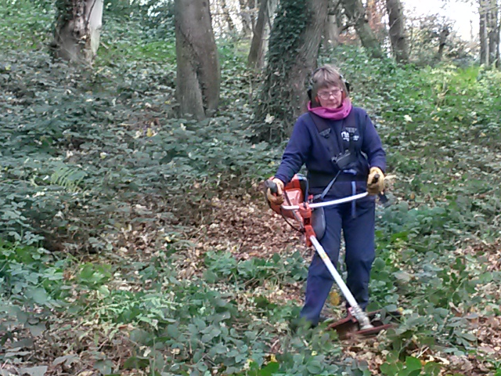
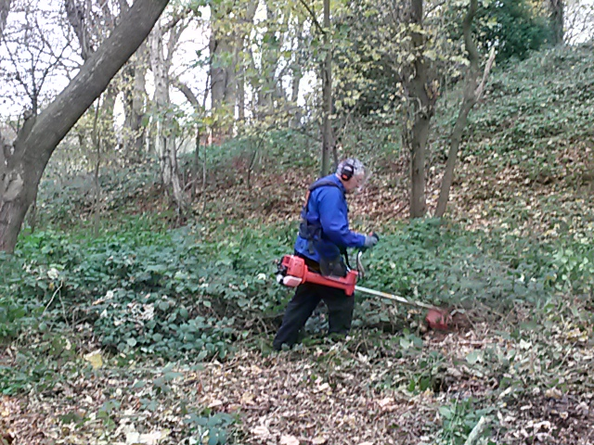
November 2016: the first clearance work with Norwich Fringe and FOTV volunteers

Slide 7
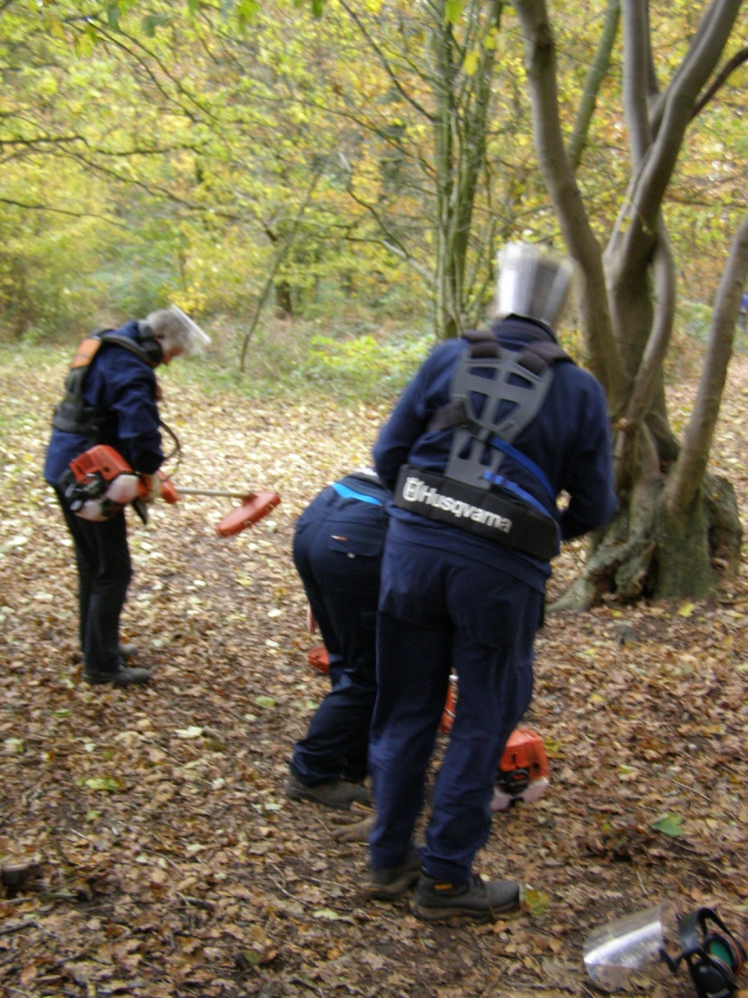
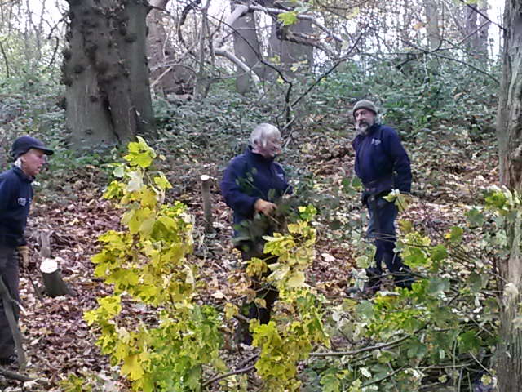
Many hands DO make light work!

Slide 8
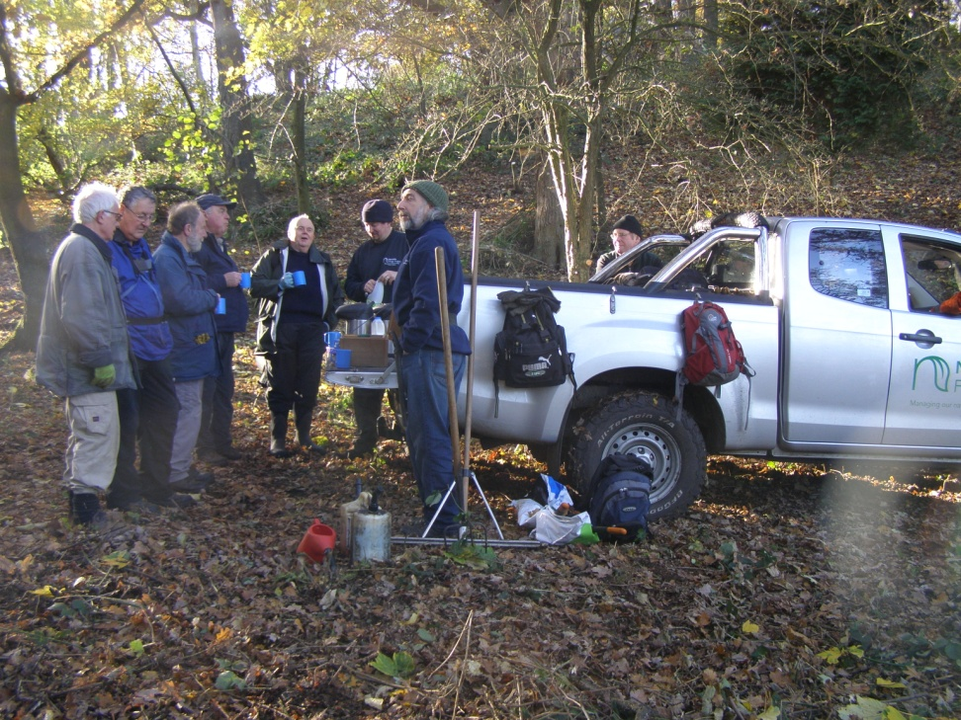
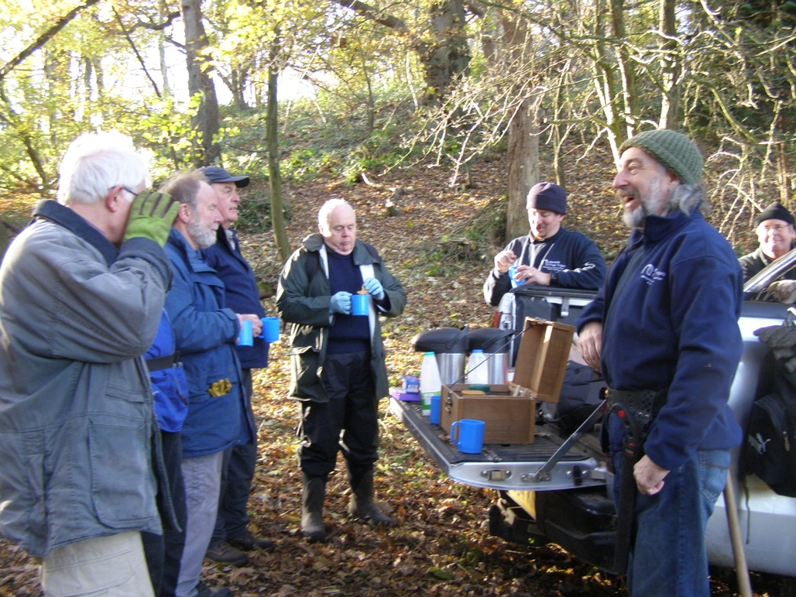
Time for a break!

Slide 9
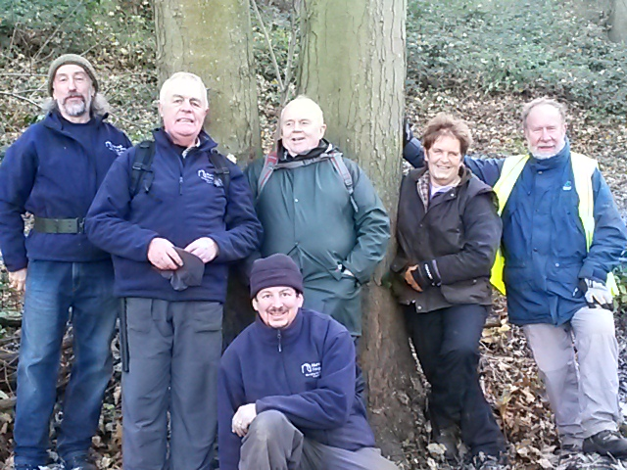
Thanks to these guys:

Slide 10
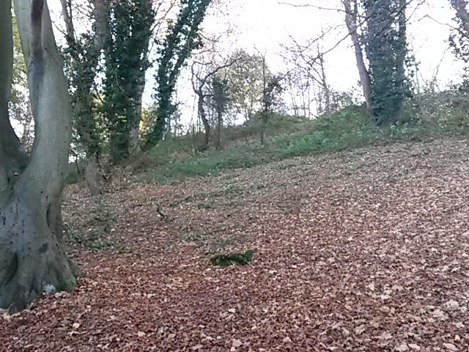
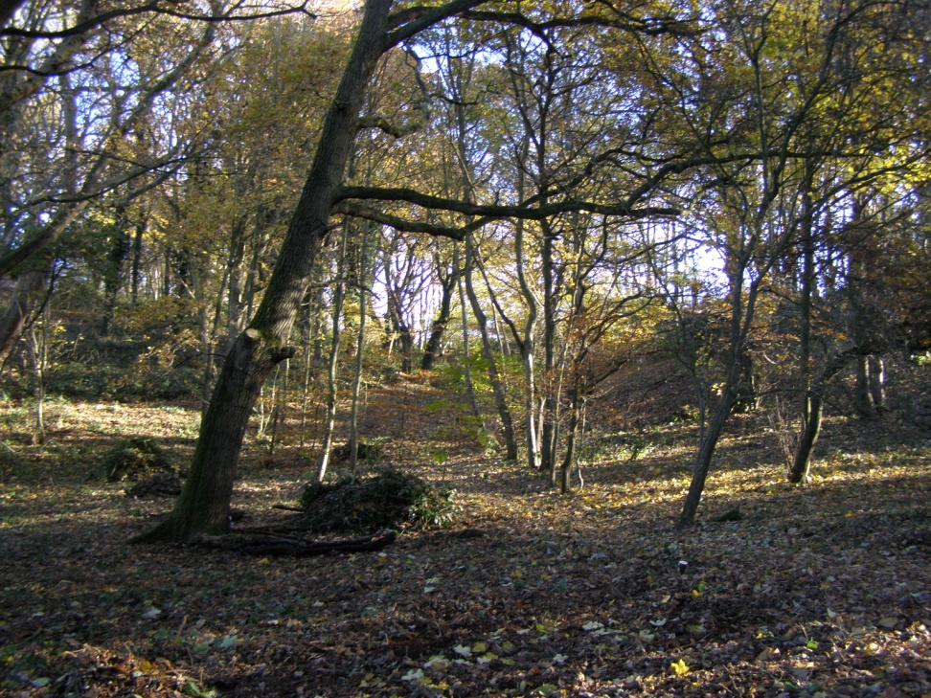
The result

Slide 11
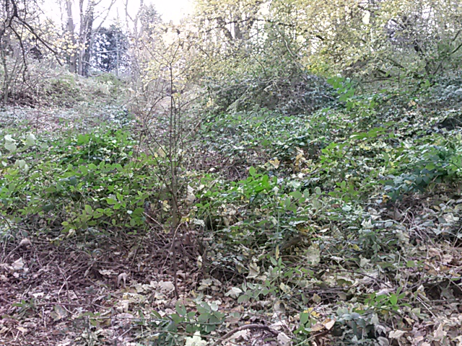
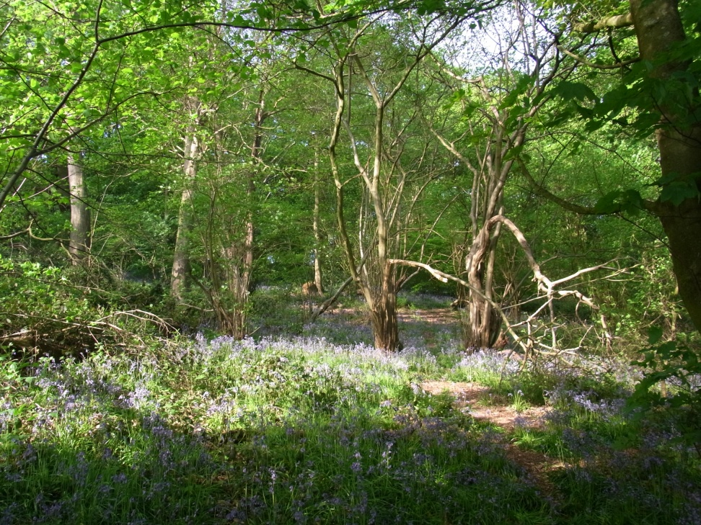
We need your help!
From this
Back to this!

Slide 12
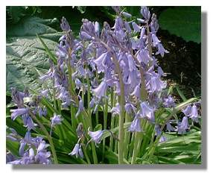
2017 - A New Year’s Resolution:
Join our “Green Gym”!
Free membership
Fresh air
No Lycra necessary
Good company

